Slide 1
Circular Flow of Income in Two-sector Economy (with Financial Market)

Slide 2
Circular Flow in a Two-sector Economy (with Financial Market)
In the circular flow of an economy in a two-sector model without the financial market, it is assumed that no savings are made in the economy. It means that the households spend their entire income on the purchase of goods and services and every firm spends all the receipts from the sale of goods and services to make factor payments.

Slide 3
Circular Flow in a Two-sector Economy (with Financial Market)
However, it does not happen in the actual world, i.e., households do not spend their entire income on the consumption of goods and services. Instead, they save a part of their income for the future. In the same way, the firms save some part of their receipts for the expansion of business or various other reasons. Besides, the firms also borrow money from outside to finance their expansion plans. All of these savings and borrowings happening in the economy are channelized through the financial market. Therefore, in a two-sector economy, the savings made by households accumulated in the financial market are used by the firms for investment purposes.

Slide 4
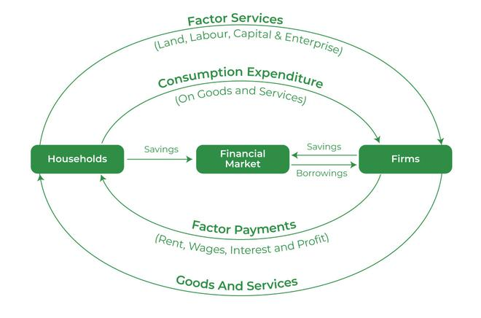
This concept can be better understood with the help of the following diagram:

Slide 5
Financial system is essential for the working of modern economy. Financial institutions are intermediaries between savers and investors.
Features of financial system are:
All savings by households and firms go to the financial market.
Financial market invest this money by lending out to firms and households. Firms made money to finance new investment in plant and equipments. Households needs money to build assets like house, etc.

Slide 6
In this case leakage are savings by households and firms. But when firms borrow this money for investment purposes from financial system then they become injections into the circular flow .
Savings are leakages and Investments are injections. Important condition is that leakages must be equal to injections. Saving and Investment are essential for capital formation in a country.

Slide 7
THANK YOU

